Slide 1
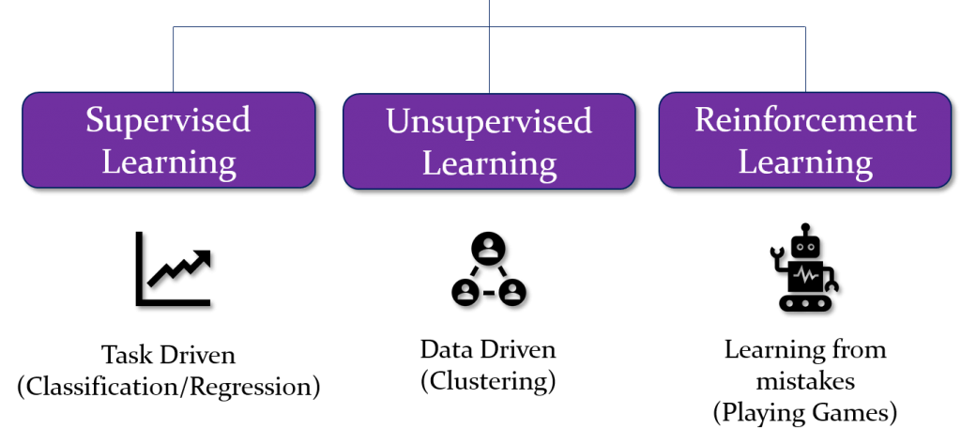
Types of Machine Learning

Slide 2
Supervised Learning
The model learns from labeled data, where each input has a known output. Example: Predicting house prices based on features like size and location.
Rooms | Size | Location | price | Sale
10 | 45 | Lahore | 10000 | Yes
3 | 34 | Karachi | 4000 | No
30 | 2 | Islamabad | 4000000 | Yes

Slide 3
Unsupervised Learning
The model finds patterns in unlabeled data without predefined outputs. Example: Customer segmentation in marketing using clustering.
Age | Purchase | Items | Duration
30 | 4500 | Phones | 3 Hours
51 | 1000 | Foam | 1 Hours
40 | 5000 | Phones | 5 Hours
Groups
Phone Cluster
Foam Cluster
Phone Cluster

Slide 4
Semi-Supervised Learning
Uses both labeled and unlabeled data to improve learning efficiency. Example: A spam detection model trained on a few labeled emails and many unlabeled ones.
Text | Label
This is scam | Scam
This is good | No scam
This is scam | Scam
Text | No label
This is spam
Fine one
Bad one

Slide 5
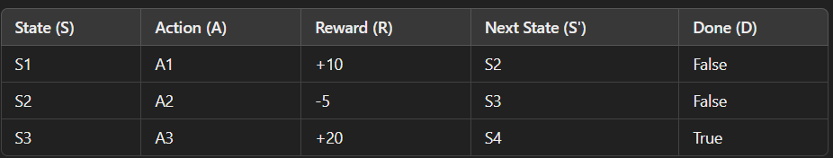
Reinforcement learning
The model learns by trial and error, receiving rewards for correct actions. Example: A self-driving car learning to navigate by maximizing safety and efficiency.

